Slide 1
DBMS

Slide 2
INTRODUCTION
Database is a collection of related data.
Database management system is software designed to assist the maintenance and utilization of large scale collection of data.
DBMS came into existence in 1960 by Charles Bachman. Integrated data store which is also called as the first general purpose DBMS.
Again in 1960 IBM brought IMS-Information management system.
In 1970 Edgor Codd at IBM came with new database called RDBMS.
In 1980 then came SQL Architecture- Structure Query Language.
In 1980 to 1990 there were advances in DBMS e.g. DB2, ORACLE.

Slide 3
Data
Data is raw fact or figures or entity.
When activities in the organization takes place, the effect of these activities need to be recorded which is known as Data.
Information
Processed data is called information
The purpose of data processing is to generate the information required for carrying out the business activities.

Slide 4
In general data management consists of following tasks
• Data capture: Which is the task associated with gathering the data as and when
they originate.
• Data classification: Captured data has to be classified based on the nature and
intended usage.
• Data storage: The segregated data has to be stored properly.
• Data arranging: It is very important to arrange the data properly
• Data retrieval: Data will be required frequently for further processing,
Hence it is very important to create some indexes so that data can be retrieved easily

Slide 5
Cont….
• Data maintenance: Maintenance is the task concerned with keeping the data upto-date.
• Data Verification: Before storing the data it must be verified for any error.
• Data Coding: Data will be coded for easy reference.
• Data Editing: Editing means re-arranging the data or modifying the data for presentation.
• Data transcription: This is the activity where the data is converted from one form into another.
• Data transmission: This is a function where data is forwarded to the place where it would be used further.

Slide 6
Metadata
Metadata (meta data, or sometimes meta information) is "data about data", of any sort in any media.
An item of metadata may describe a collection of data including multiple content items and hierarchical levels, for example a database schema.
Eg: A text document's metadata may contain information about how long the document is, who the author is, when the document was written, and a short summary of the document.
Metadata within web pages can also contain descriptions of page content, as well as key words linked to the content.^{[14]} These links are often called "Metatags",

Slide 7
Database:
• Database may be defined in simple terms as a collection of data
• A database is a collection of related data.
• The database can be of any size and of varying complexity.
• A database may be generated and maintained manually or it may be computerized.
Database Management System - A Database Management System (DBMS) is a collection of program that enables user to create and maintain a database.

Slide 8
Difference between File system & DBMS
File System
1. File system is a collection of data. Any management with the file system, user has to write the procedures
2. File system gives the details of the data representation and Storage of data.
3. In File system storing and retrieving of data cannot be done efficiently.
4. Concurrent access to the data in the file system has many problems like
a. Reading the file while other deleting some information, updating some information
5. File system doesn’t provide crash recovery mechanism.
6. Protecting a file under file system is very difficult.
DBMS
1. DBMS is a collection of data and user is not required to write the procedures for managing the database.
2. DBMS provides an abstract view of data that hides the details.
3. DBMS is efficient to use since there are wide varieties of sophisticated techniques to store and retrieve the data.
4. DBMS takes care of Concurrent access using some form of locking.
5. DBMS has crash recovery mechanism, DBMS protects user from the effects of system failures.
6. DBMS has a good protection mechanism.

Slide 9
Advantages of DBMS.
1. Data independency:
Application program should not be exposed to details of data representation and storage
DBMS provides the abstract view that hides these details.
2. Efficient data access.:
DBMS utilizes a variety of sophisticated techniques to store and retrieve data
efficiently.
3. Data integrity and security:
Data is accessed through DBMS, it can enforce integrity constraints.
E.g.: Inserting salary information for an employee.

Slide 10
Cont….
4. Data Administration:
When users share data, centralizing the data is an important task, Experience
professionals can minimize data redundancy and perform fine tuning which reduces
retrieval time.
5. Concurrent access and Crash recovery:
DBMS schedules concurrent access to the data. DBMS protects user from the effects of
system failure.
6. Reduced application development time.
DBMS supports important functions that are common to many applications.

Slide 11
Functions of DBMS
• Data Definition: The DBMS provides functions to define the structure of the data in the application. These include defining and modifying the record structure, the type and size of fields and the various constraints to be satisfied by the data in each field.
• Data Manipulation: Once the data structure is defined, data needs to be inserted, modified or deleted. These functions which perform these operations are part of DBMS.
• Data Security & Integrity: The DBMS contains modules which handle the
security and integrity of data in the application.

Slide 12
Cont…..
• Data Recovery and Concurrency: Recovery of the data after system failure and
concurrent access of records by multiple users is also handled by DBMS.
• Data Dictionary Maintenance: Maintaining the data dictionary which contains the
data definition of the application is also one of the functions of DBMS.
• Performance: Optimizing the performance of the queries is one of the important
functions of DBMS.

Slide 13
Role of Database Administrator.
Typically there are three types of users for a DBMS:
1. The END User who uses the application. Ultimately he is the one who actually
puts the data into the system into use in business. This user need not know
anything about the organization of data in the physical level.
2. The Application Programmer who develops the application programs. He/She has
more knowledge about the data and its structure. He/she can manipulate the data
using his/her programs. He/she also need not have access and knowledge of the
complete data in the system.
3. The Data base Administrator (DBA) who is like the super-user of the system.

Slide 14
The role of DBA is very important and is defined by the following functions.
• Defining the schema: The DBA defines the schema which contains the structure of the data in the application. The DBA determines what data needs to be present in the system and how this data has to be presented and organized.
• Liaising with users: The DBA needs to interact continuously with the users to understand the data in the system and its use.
• Defining Security & Integrity checks: The DBA finds about the access restrictions to be defined and defines security checks accordingly. Data Integrity checks are defined by the DBA.
• Defining Backup/Recovery Procedures: The DBA also defines procedures for backup and recovery. Defining backup procedure includes specifying what data is to be backed up, the periodicity of taking backups and also the medium and storage place to backup data.
• Monitoring performance: The DBA has to continuously monitor the performance of the queries and take the measures to optimize all the queries in the application.

Slide 15
Simplified Database System Environment:
A database management system (DBMS) is a collection of programs that enables users to create and maintain database.
The DBMS is a general purpose software system that facilitates the process of defining, constructing, manipulating and sharing databases among various users and applications.
Defining a database specifying the database involves specifying the data types, constraints and structures of the data to be stored in the database.
The descriptive information is also stored in the database in the form database catalog or dictionary; it is called meta-data.
Manipulating the data includes the querrying the database to retrieve the specific data. An application program accesses the database by sending the qurries or requests for data to DBMS.
The important function provided by the DBMS includes protecting the database and maintain the database.

Slide 16
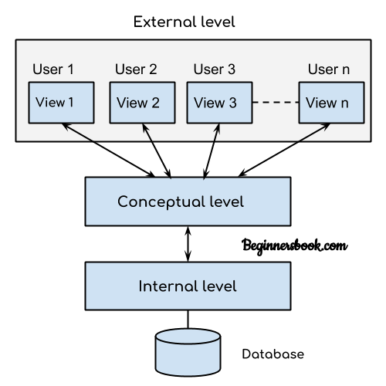

Slide 17
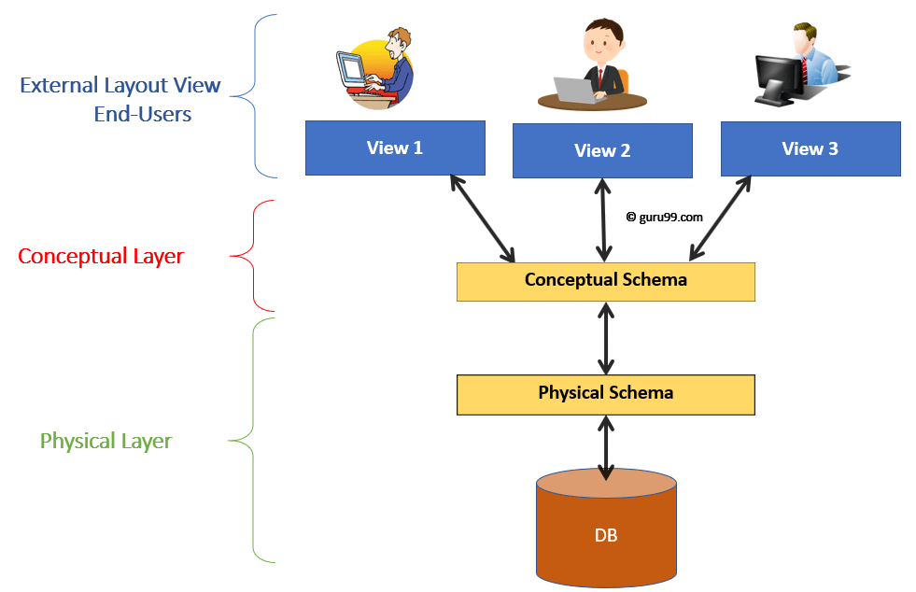

Slide 18
Architecture of DBMS
A commonly used views of data approach is the three-level architecture suggested by ANSI/SPARC (American National Standards Institute/Standards Planning and Requirements Committee).
The three levels of the architecture are three different views of the data:
External - individual user view
Conceptual - community user view
Internal - physical or storage view

Slide 19
external level
The external level is the view that the individual user of the database has. This view is often a restricted view of the database and the same database may provide a number of different views for different classes of users.
For example, a department head may only be interested in the departmental finances and student enrolments but not the library information. The librarian would not be expected to have any interest in the information about academic staff.
s/w and h/w independent

Slide 20
The conceptual view
The conceptual view is the information model of the enterprise and contains the view of the whole enterprise without any concern for the physical implementation. This view is normally more stable than the other two views.
In a database, it may be desirable to change the internal view to improve performance while there has been no change in the conceptual view of the database.
The conceptual view is defined by the conceptual schema which includes definitions of each of the various types of data.
Overall view keeping in consideration od DBMS software to be used, hence this view is dependent on s/w but not on h/w

Slide 21
The internal view
The internal view is the view about the actual physical storage of data. It tells us what data is stored in the database and how.
At least the following aspects are considered at this level:
Storage allocation e.g. B-trees, hashing etc.
Access paths e.g. specification of primary and secondary keys, indexes and pointers and sequencing.
Miscellaneous e.g. data compression and encryption techniques, optimization of the internal structures.
At least the following aspects are considered at this level: Storage allocation e.g. B-trees, hashing etc. Access paths e.g. specification of primary and secondary keys, indexes and pointers and sequencing. Miscellaneous e.g. data compression and encryption techniques, optimization of the internal structures.
Both s/w and h/w dependent.

Slide 22
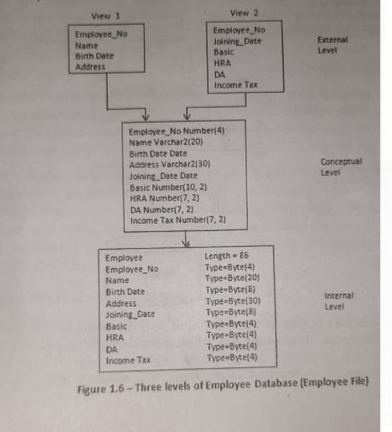

Slide 23
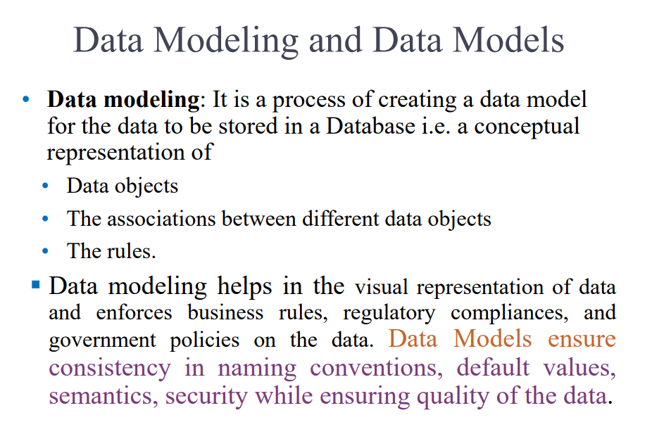

Slide 24
DBMS Schemas: Internal, Conceptual, External
The database schema of a database is its structure described in a formal language supported by the database management system (DBMS). The term "schema" refers to the organization of data as a blueprint of how the database is constructed (divided into database tables in the case of relational databases).
The design of a database at physical level is called physical schema, how the data stored in blocks of storage is described at this level.
Design of database at logical level is called logical schema, programmers and database administrators work at this level, at this level data can be described as certain types of data records gets stored in data structures, however the internal details such as implementation of data structure is hidden at this level (available at physical level).
Design of database at view level is called view schema. This generally describes end user interaction with database systems.

Slide 25
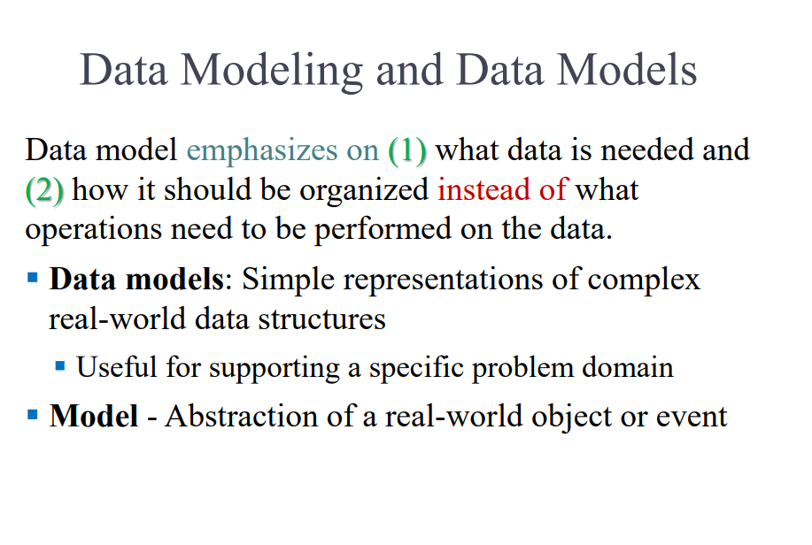

Slide 26
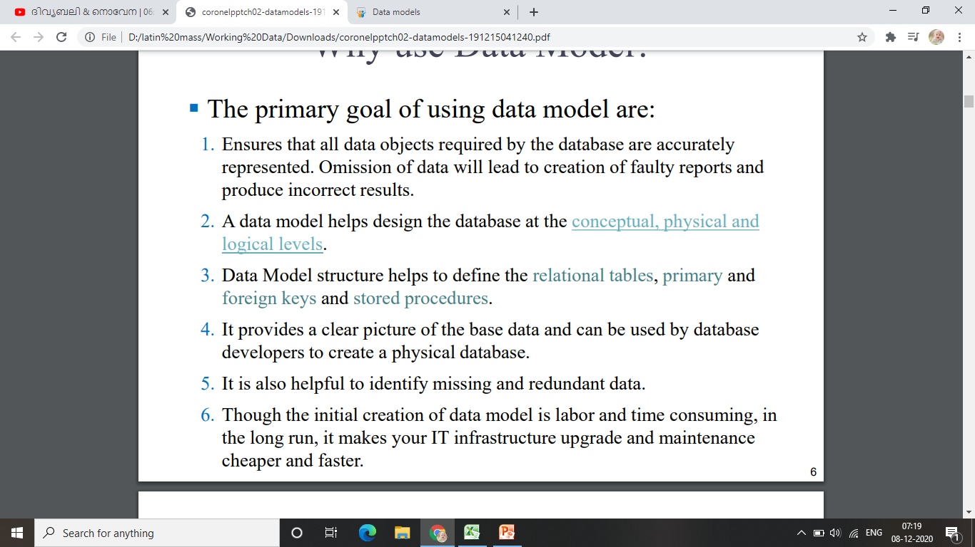

Slide 27
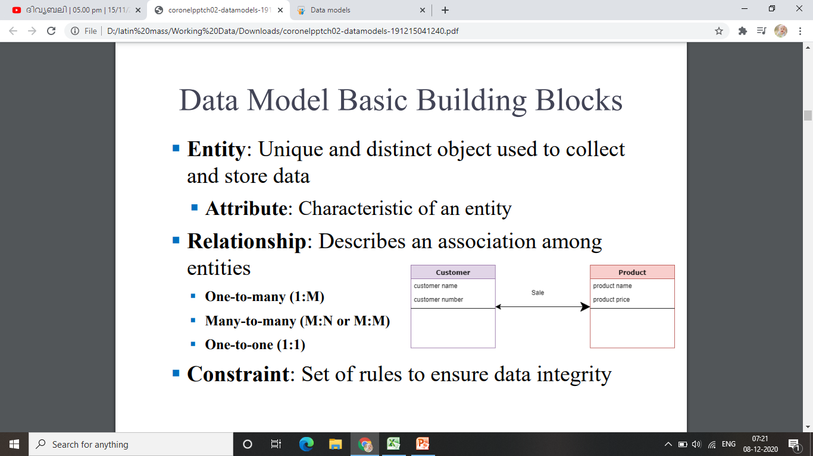

Slide 28
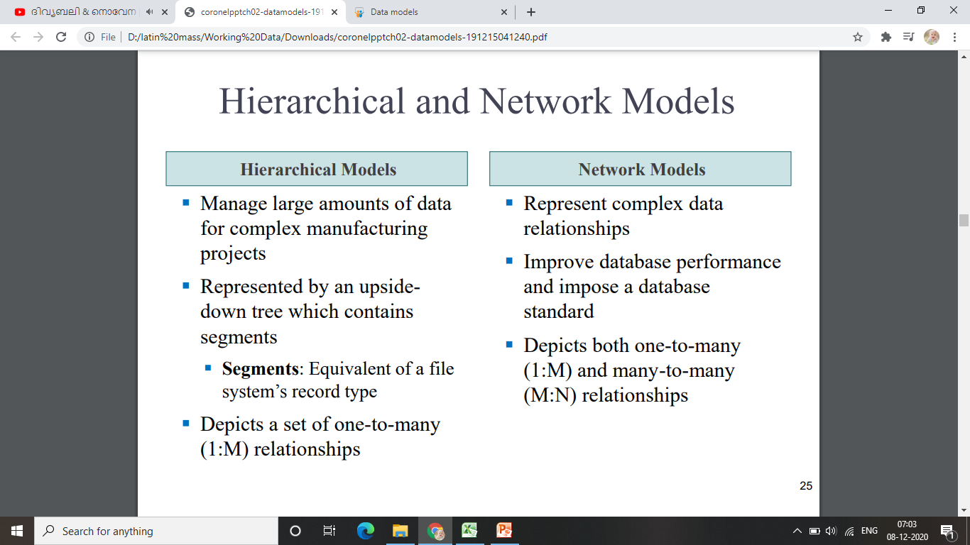
Relational database Model

Slide 29
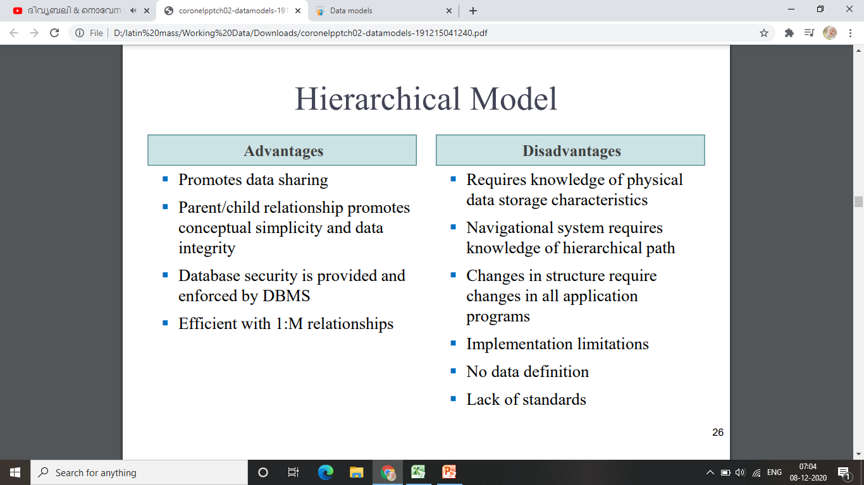

Slide 30
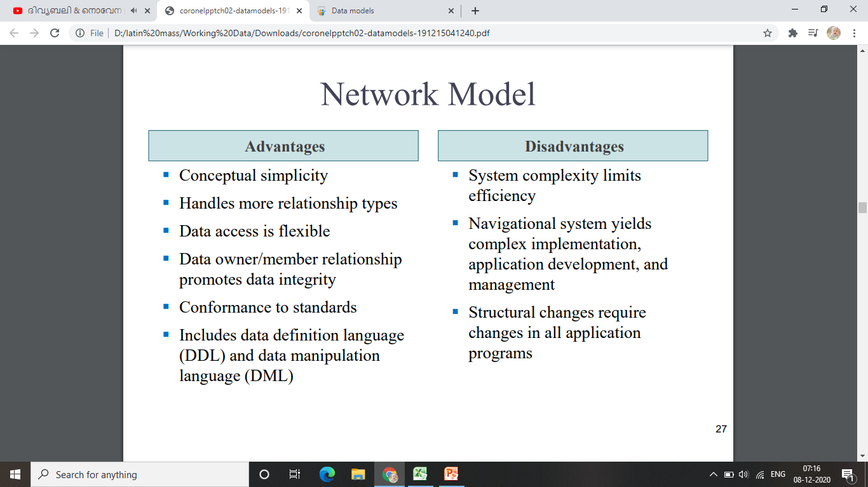

Slide 31
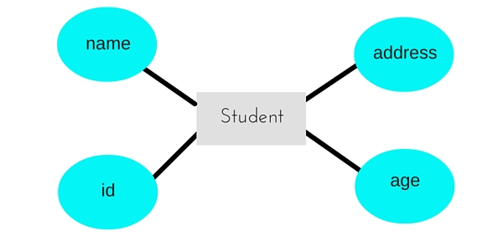
Entity-relationship Model
In this database model, relationships are created by dividing object of interest into entity and its characteristics into attributes.
Different entities are related using relationships.
E-R Models are defined to represent the relationships into pictorial form to make it easier for different stakeholders to understand.
This model is good to design a database, which can then be turned into tables in relational model(explained below).
Let's take an example, If we have to design a School Database, then Student will be an entity with
attributes name, age, address etc.
As Address is generally complex, it can
be another entity with attributes
street name,pincode, city etc, and
there will be a relationship between them

Slide 32
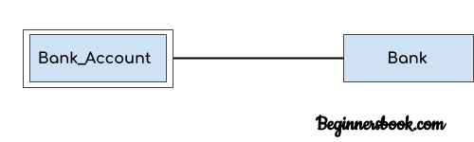
ER diagram : Components
ER diagram shows the complete logical structure of a database.
Entity
An entity is an object or component of data. An entity is represented as rectangle in an ER diagram.
An entity might be
An object with physical existence (e.g., a lecturer, a student, a car)
An object with conceptual existence (e.g., a course, a job, a position)
An entity set is a collection of entities of an entity type at a particular point of time. An entity set is a set of entities of the same type (e.g., all persons having an account at a bank).
Weak Entity: An entity that cannot be uniquely identified by its own attributes and relies on the relationship with other entity is called weak entity. The weak entity is represented by a double rectangle. For example – a bank account cannot be uniquely identified without knowing the bank to which the account belongs, so bank account is a weak entity.

Slide 33
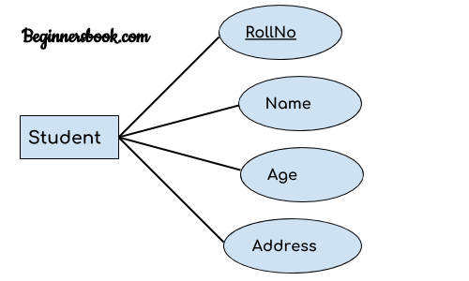
ERD- Components
2. Attribute
An attribute describes the property of an entity. An attribute is represented as Oval in an ER diagram. There are four types of attributes:
1. Key attribute 2. Composite attribute 3. Multivalued attribute 4. Derived attribute
1. Key attribute:
A key attribute can uniquely identify an entity from an entity set. For example, student roll number can uniquely identify a student from a set of students. Key attribute is represented by oval same as other attributes however the text of key attribute is underlined.

Slide 34
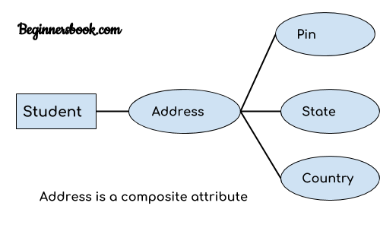
2. Composite attribute:
An attribute that is a combination of other attributes is known as composite attribute. For example, In student entity, the student address is a composite attribute as an address is composed of other attributes such as pin code, state, country.

Slide 35
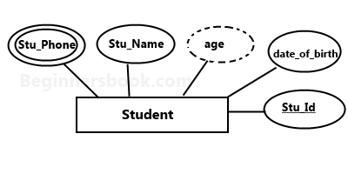
3. Multivalued attribute:
An attribute that can hold multiple values is known as multivalued attribute. It is represented with double ovals in an ER Diagram. For example – A person can have more than one phone numbers so the phone number attribute is multivalued.
4. Derived attribute:
A derived attribute is one whose value is dynamic and derived from another attribute. It is represented by dashed oval in an ER Diagram. For example – Person age is a derived attribute as it changes over time and can be derived from another attribute (Date of birth).

Slide 36
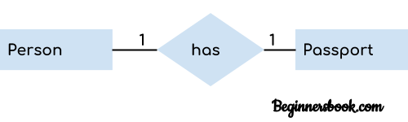
Relationship
3. Relationship
A relationship is represented by diamond shape in ER diagram, it shows the relationship among entities. There are four types of relationships: 1. One to One 2. One to Many 3. Many to One 4. Many to Many
1. One to One Relationship
When a single instance of an entity is associated with a single instance of another entity then it is called one to one relationship. For example, a person has only one passport and a passport is given to one person.

Slide 37
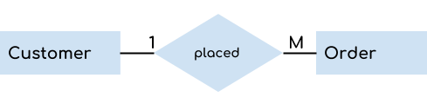
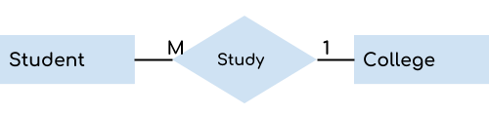
One to Many Relationship
When a single instance of an entity is associated with more than one instances of another entity then it is called one to many relationship. For example – a customer can place many orders but a order cannot be placed by many customers.
3. Many to One Relationship
When more than one instances of an entity is associated with a single instance of another entity then it is called many to one relationship. For example – many students can study in a single college but a student cannot study in many colleges at the same time.

Slide 38

Bridge-entity
A bridge entity is used to capture a many-to-many relationship that cannot be accommodated by the natural granularity of a single fact or dimension entity. A bridge entity serves to bridge between the fact and dimension entities to support many-valued dimension attributes.
A composite entity is also
known as a “bridge” entity.
This “bridge” is used to handle
the many-to-many relationships
that the traditional entity could not handle. This entity lies between the two entities that are of interest and this composite entity shares the
primary keys from both the connecting
tables.

Slide 39
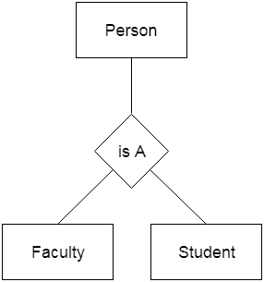
Generalization is a process in which the common attributes of more than one entities form a new entity. This newly formed entity is called generalized entity.
1. Generalization uses bottom-up approach where two or more lower level entities combine together to form a higher level new entity. 2. The new generalized entity can further combine together with lower level entity to create a further higher level generalized entity.

Slide 40
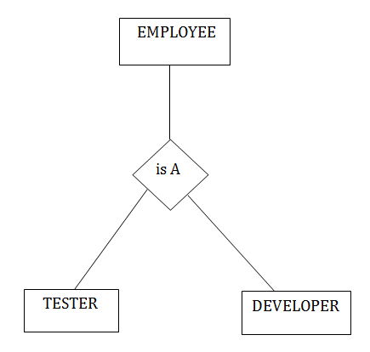
Specialization is a process in which an entity is divided into sub-entities. You can think of it as a reverse process of generalization, in generalization two entities combine together to form a new higher level entity. Specialization is a top-down process.
The idea behind Specialization is to find the subsets of entities that have few distinguish attributes. For example – Consider an entity employee which can be further classified as sub-entities Technician, Engineer & Accountant because these sub entities have some distinguish attributes.

Slide 41
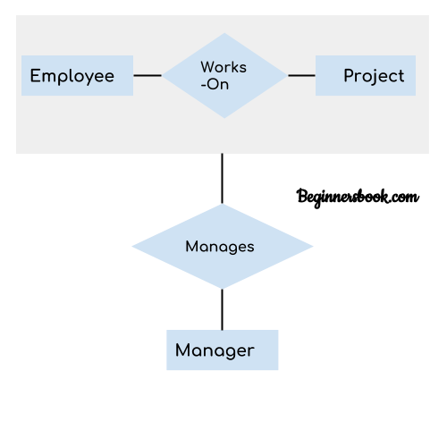
Aggregation
In aggregation, the relation between two entities is treated as a single entity. In aggregation, relationship with its corresponding entities is aggregated into a higher level entity.
In real world, we know that a manager not only manages
the employee working under them but he has to manage
the project as well. In such scenario if entity “Manager”
makes a “manages” relationship with either “Employee” or “Project” entity alone then it will not make any sense because he has to manage both. In these cases the relationship of two entities acts as one entity. In our example, the relationship “Works-On” between “Employee” & “Project” acts as one entity that has a relationship “Manages” with
the entity “Manager”.

Slide 42
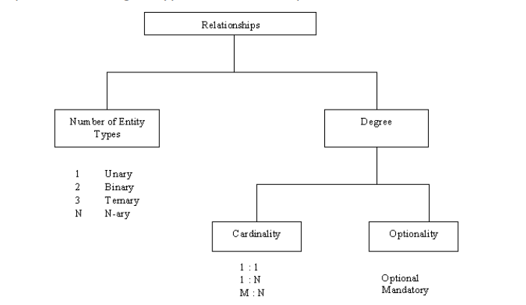
Relationships
Ways of Classifying Relationships Types
A relationship type can be classified by the number of entity types involved, and by the degree of the relationship type.

Slide 43
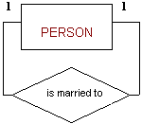

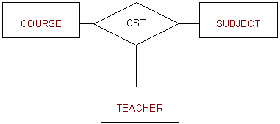
Degree
The degree of a relationship is the number of entity types that participate in the relationship. The three most common relationships in ER models are Binary, Unary and Ternary
A unary relationship is when both participants in the relationship are the same entity.
A binary relationship is when two entities participate and is the most common relationship degree
A ternary relationship is when three entities participate in the relationship

Slide 44
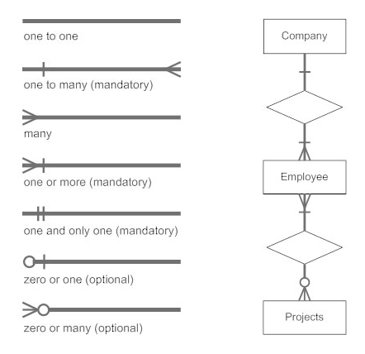
Notations for ERD

Slide 45

Connectivity :
connectivity is used to describe the relationship classification. Just to show the relation existence and type of relation between entities.
Cardinality: expresses the minimum and maximum number of entity occurrences associated with one occurrence of the related entity. In the ERD, cardinality is indicated by placing the appropriate numbers beside the entities, using the format (min , max).
Teachers may teach 0 subjects if they are involved in non teaching projects. Therefore, the cardinality limits for TEACHER are (O,N).
Each Subject is taught by only one teacher, but it is possible to have Subjects that have not yet been assigned a teacher. Therefore, the cardinality limits for SUBJECT are (0,1).

Slide 46


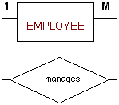
Existence Dependency
Weak Entity
A weak entity is an entity type that, in addition to being existence dependent, has a primary key that has been totally or partially constructed from the entity it depends on
DEPARTMENT
EMPLOYEE
Mandatory/Optional Relationships:
Participation by an entity in a relationship may be optional or mandatory.
Recursive Relationships

Slide 47
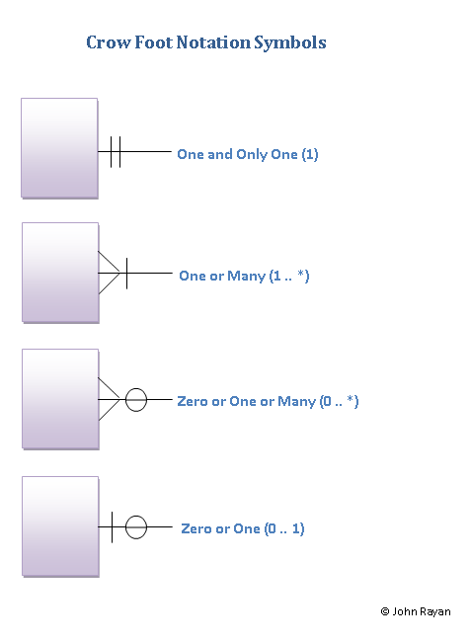
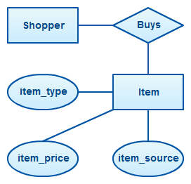

Slide 48
ERDS
An ER model is typically drawn at up to three levels of abstraction:
Conceptual ERD / Conceptual data model
Logical ERD / Logical data model
Physical ERD / Physical data model
While all the three levels of an ER model contain entities with attributes and relationships, they differ in the purposes they are created for and the audiences they are meant to target.

Slide 49
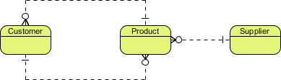
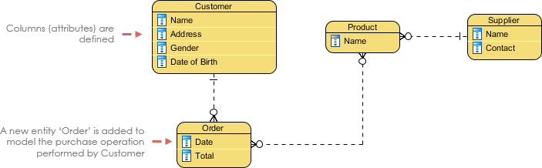
Conceptual ERD models the business objects that should exist in a system and the relationships between them.
Logical ERD is a detailed version of a Conceptual ERD. A logical ER model is developed to enrich a conceptual model by defining explicitly the columns in each entity and introducing operational and transactional entities.

Slide 50
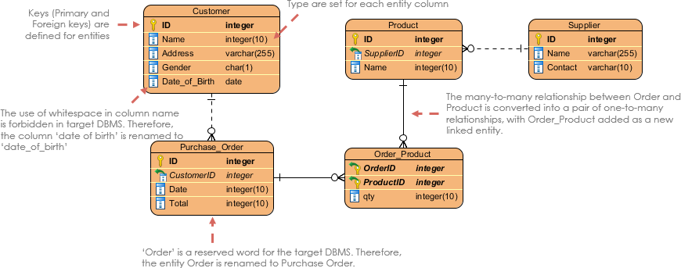
Physical ERD represents the actual design blueprint of a relational database. A physical data model elaborates on the logical data model by assigning each column with type, length, nullable, etc. Since a physical ERD represents how data should be structured and related in a specific DBMS it is important to consider the convention and restriction of the actual database system in which the database will be created.

Slide 51
ERD
ER diagram of Company has the following description :
Company has several departments.
Each department may have several Location.
Departments are identified by a name, D_no, Location.
A Manager control a particular department.
Each department is associated with number of projects.
Employees are identified by name, id, address, dob, dat e_of_joining.
An employee works in only one department but can work on several project.
We also keep track of number of hours worked by an employee on a single project.
Each employee has dependent
Dependent has D_name, Gender and relationship.

Slide 52
AN ENTITY RELATIONSHIP DIAGRAM METHODOLOGY
1. Identify Entities | Identify the roles, events, locations, tangible things or concepts about which the end-users want to store data.
2. Find Relationships | Find the natural associations between pairs of entities using a relationship matrix.
3. Draw Rough ERD | Put entities in rectangles and relationships on line segments connecting the entities.
4. Fill in Cardinality | Determine the number of occurrences of one entity for a single occurrence of the related entity.
5. Define Primary Keys | Identify the data attribute(s) that uniquely identify one and only one occurrence of each entity.
6. Draw Key-Based ERD | Eliminate Many-to-Many relationships and include primary and foreign keys in each entity.
7. Identify Attributes | Name the information details (fields) which are essential to the system under development.
8. Map Attributes | For each attribute, match it with exactly one entity that it describes.
9. Draw fully attributed ERD | Adjust the ERD from step 6 to account for entities or relationships discovered in step 8.
10. Check Results | Does the final Entity Relationship Diagram accurately depict the system data?

Slide 53
A company has several departments. Each department has a supervisor and at least one employee. Employees must be assigned to at least one, but possibly more departments. At least one employee is assigned to a project, but an employee may be on vacation and not assigned to any projects. The important data fields are the names of the departments, projects, supervisors and employees, as well as the supervisor and employee number and a unique project number.
We construct the following Entity Relationship Matrix:
 | Department | Employee | Supervisor | Project
Department |  | is assigned | run by
Employee | belongs to |  |  | works on
Supervisor | runs
Project |  | uses

Slide 54
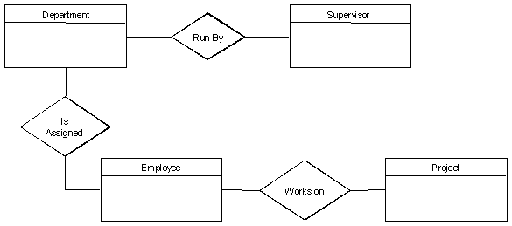
Rough ERD

Slide 55
Fill in Cardinality
From the description of the problem we see that: Each department has exactly one supervisor.
A supervisor is in charge of one and only one department.
Each department is assigned at least one employee.
Each employee works for at least one department.
Each project has at least one employee working on it.
An employee is assigned to 0 or more projects.

Slide 56
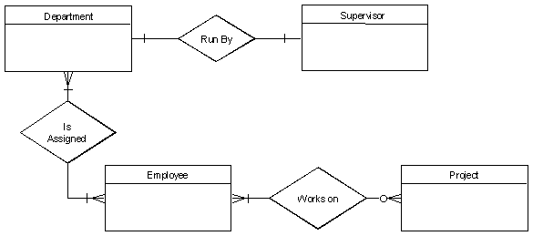

Slide 57
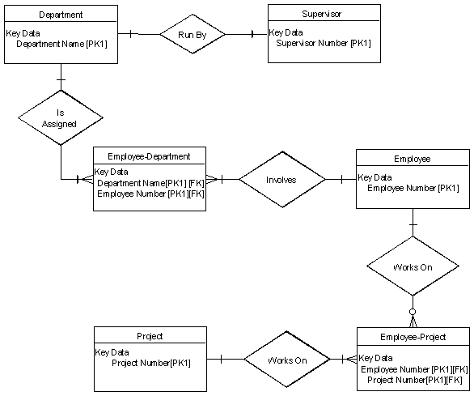

Slide 59
Data Independence
Data independence can be defined as the capacity to change the schema at one level without changing the schema at next higher level. There are two types of data Independence.
They are
1. Logical data independence.
2. Physical data independence.
1. Logical data independence is the capacity to change the conceptual schema without having to change the external schema.
2. Physical data independence is the capacity to change the internal schema without changing the conceptual schema.

Slide 60
Types of Databases and Database Applications • Traditional Applications:
Numeric and Textual Databases
• More Recent Applications:
Multimedia Databases
Geographic Information Systems (GIS)
Data Warehouses Real-time
and Active Databases Many other application

